Slide 1
Innovative Accessibility Design for Hardware with Closed Functionality
Presented By: ​
Bill Curtis-Davidson​
Senior Director, Strategic Consulting Services​
CSUN 2018 Assistive Technology Conference
March 21, 2018

Slide 2

Agenda
Innovative Accessibility Design for Hardware with Closed Functionality
What is Closed Functionality?
Accessibility Legal Requirements
Accessible Design Examples
Government Field Office Kiosk
Printer Manufacturer
Implications for Solution Providers
Q&A and Resources

Slide 3
What is Closed Functionality?

Slide 4


What is “Closed Functionality?”
Innovative Accessibility Design for Hardware with Closed Functionality
Limited functionality by design
Prevents users from attaching or installing assistive technology
Due to nature of product, or due to policies such as info security
Can be shared or personal use
Increasingly common due to explosion of devices with embedded I/T functionality

Slide 5

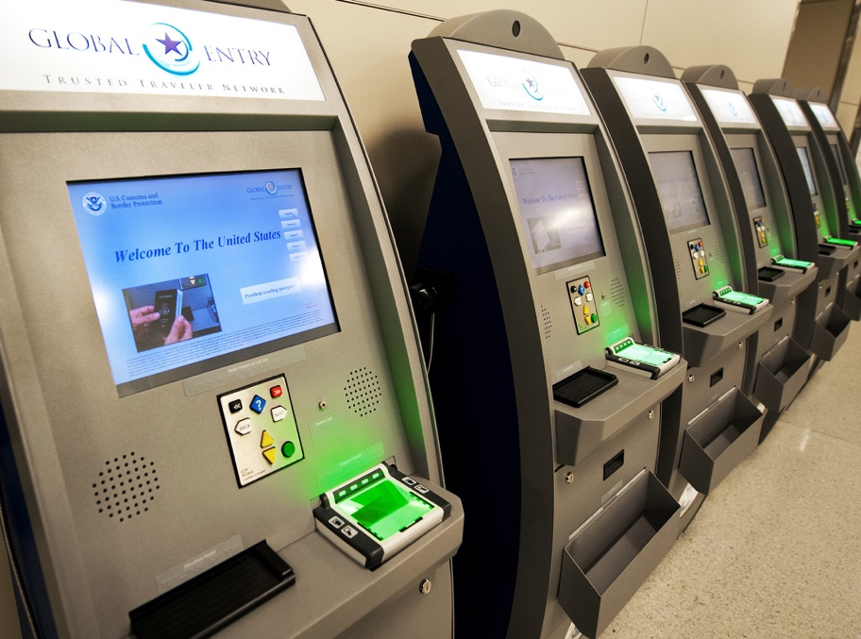
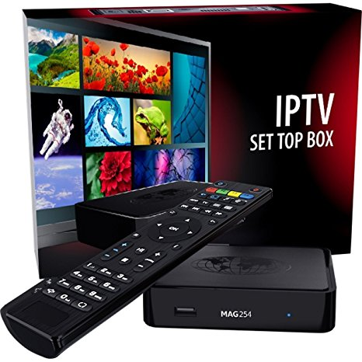
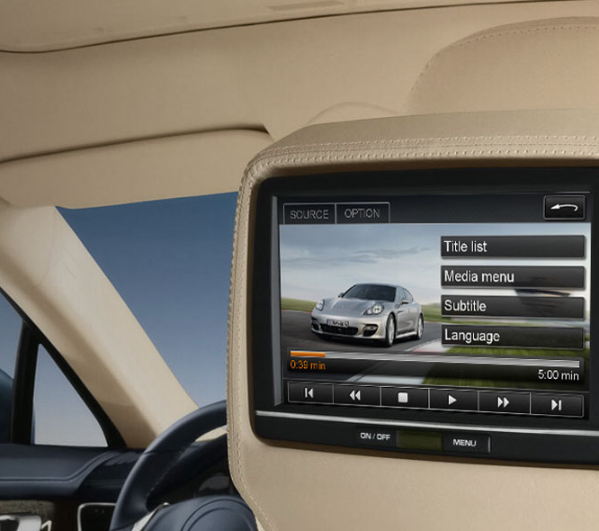
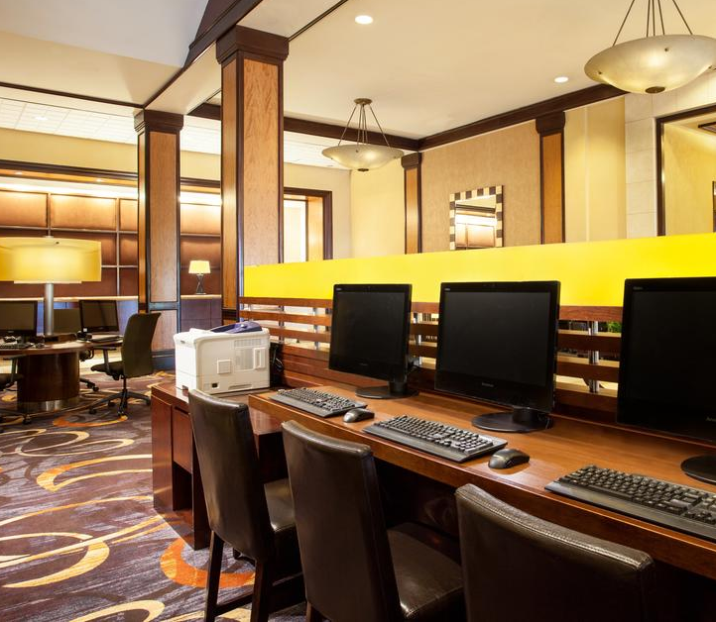
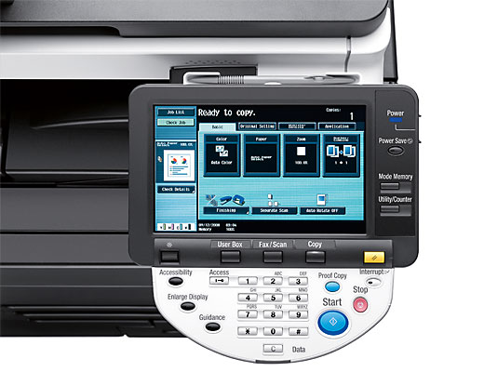
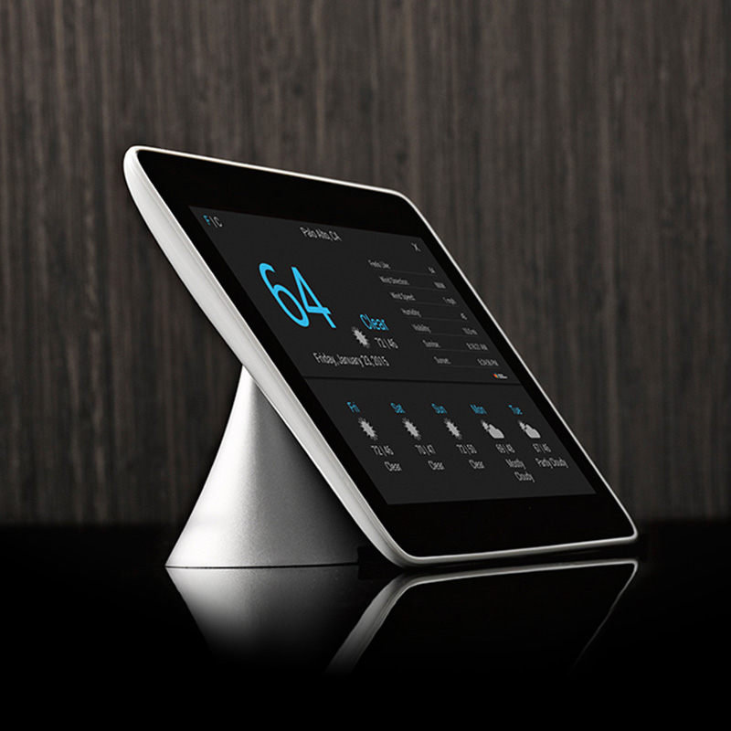
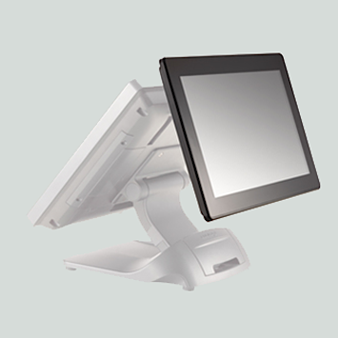
Closed Functionality Examples
Innovative Accessibility Design for Hardware with Closed Functionality
Self-Service Kiosks
Set-Top Boxes
Entertainment
Locked Computers
Print / Copy / Fax
IoT Devices
Point-of-Sale Units

Slide 6
Accessibility Legal Requirements

Slide 7
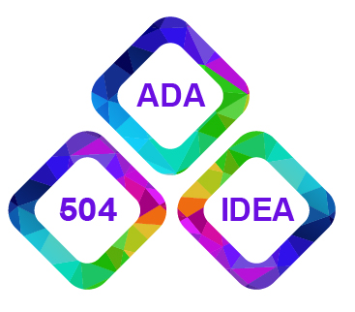
Closed Functionality Access in Laws
Innovative Accessibility Design for Hardware with Closed Functionality
Accessibility laws requiring hardware with closed functionality to be accessible:
Americans with Disabilities Act (ADA) – 2010 Design Guidelines, Section 220 includes requirements for ATMs and Fare Machines
Section 508 Refresh – Chapter 4 Hardware addresses closed functionality
CVAA – Impacts products with video programming and advanced text, voice, video communication (e.g. set-top boxes, media players, game platforms, etc.)
ADA
508
CVAA

Slide 8
Section 508 Refresh – Hardware
Innovative Accessibility Design for Hardware with Closed Functionality
Closed Functionality
Biometrics
Preserving Accessibility Information
Privacy
Standard Connections
Operable Parts (visual contrast, input controls, alphabetic/numeric keys, key repeat, timed responses, operation, tickets/fare cards/key cards, reach height/depth)
Display Screens
Status Indicators
Color Coding
Audible Signals
ICT with 2-Way Voice Communication
Closed Caption Processing
Audio Description Processing
User Controls for Closed Captions & Audio Description

Slide 9
Section 508 Refresh – Closed Functionality
Innovative Accessibility Design for Hardware with Closed Functionality
Must be operable without attaching assistive technology (personal devices including headphones/induction loops are not considered AT)
Products producing sound must provide incremental volume control
Characters on variable message signs must conform to the VMS standard ICC A117.1-2009, incorporated by reference
Following applies to closed products that include display screen:
Provide speech output for all information displayed on-screen and for all information necessary to complete a transaction.
Provide Braille instructions for initiating speech output.
Provide at least one mode that displays characters in a sans serif font and meets minimum height and contrast requirements.

Slide 10
Accessible Design Examples

Slide 11
Example #1: Government Field Office “Kiosk”
Innovative Accessibility Design for Hardware with Closed Functionality
Agency with dozens of citizen-facing field offices
“Kiosk” was actually a locked-down, secure workstation that supplements the service counter
Application supports taking photos, capturing signatures, testing knowledge, and taking payments
Needed to comply with both ADA as well as Section 508-based state government law
Functional access for those with vision, hearing or mobility impairments

Slide 12

Example #1: Blind Access to Kiosk
Innovative Accessibility Design for Hardware with Closed Functionality
Home
Government Field Office
Field Office
Accessible Kiosk
Blind
Service Counter
Home Computer
Kiosk – Braille, Headset, Keypad, Screen Reader
Application(s) accessed from home computer and kiosk should meet applicable software and web accessibility requirements.
Notes:
Blind User Scenario
Access Online Services from Home (Personal Device): Blind user accesses Government Agency online services using personal device at home or other location. Uses JAWS® for Windows screen reader or other screen reader to access accessible web application, listening to text-to-speech output via his or her headset.
Field Office Service Counter: Blind user visits Government Agency field office, visits the service counter where an agency worker gives him or her instructions for using the accessible kiosk (verbal, Braille hard copy, short URL to electronic instructions).
Field Office Accessible kiosk / Turn on Text-to-Speech (TTS): Blind user locates headset jack using Braille / other instructions, connects headset, activates JAWS® screen reader.
Field Office Accessible kiosk / Accesses Web App: Blind user completes transaction in web app, using speech output, and keyboard/keypad. On session completion, device resets to default settings.

Slide 13
Example #1: Low Vision Access to Kiosk
Innovative Accessibility Design for Hardware with Closed Functionality
Home
Government Field Office
Field Office
Accessible Kiosk
Low
Vision
Service Counter
Home Computer
Kiosk – High Contrast Mode, Screen Magnifier
Application(s) accessed from home computer and kiosk should meet applicable software and web accessibility requirements.
Notes:
Low Vision User Scenario
Access Online Services from Home (Personal Device): Low vision user accesses Government Agency online services using personal device at home or other location. Uses Windows® high contrast mode and ZoomText® screen magnification software to access web app.
Field Office Service Counter: Low vision user visits Government Agency field office, visits the service counter where an agency worker gives him or her instructions for using the accessible kiosk (verbal, large print hard copy, short URL to electronic instructions).
Field Office Accessible kiosk / Turn on Screen Magnifier & High Contrast: Low vision user selects ZoomText® screen magnifier, then activates High Contrast Mode so they can see screen.
Field Office Accessible kiosk / Accesses Web App: Low vision user completes transaction in web app, using keyboard and mouse. On session completion, device resets to default settings.

Slide 14
Example #1: Mobility/Dexterity Access to Kiosk
Innovative Accessibility Design for Hardware with Closed Functionality
Home
Government Field Office
Low
Mobility/ Dexterity
Accessible Kiosk
Field Office
Service Counter
Home Computer
Kiosk – Keypad, Keyboard Settings, Ergonomic Mouse
Application(s) accessed from home computer and kiosk should meet applicable software and web accessibility requirements.
Notes:
Low Mobility / Low Dexterity User Scenario
Access Online Services from Home (Personal Device): User with limited mobility and dexterity accesses Government Agency online services using personal device at home or other location. A wheelchair user, this person also uses special keyboard settings, and a roller mouse to effectively use the keyboard to access web content.
Field Office Service Counter: Limited mobility/dexterity user visits Government Agency field office, gets a J ticket from the Start Here window, speaks to service rep who gives her instructions for using ADA POS Device (verbal, short URL to electronic instructions).
Field Office Accessible kiosk / Turn on Text-to-Speech (TTS): Limited mobility/dexterity user locates ADA counter device, turns on keyboard settings to make keyboard and mouse easier to use.
Field Office Accessible kiosk / Accesses Web App: Limited mobility/dexterity user completes transaction in web app, using keyboard and mouse. On session completion, device resets to default settings

Slide 15
Example #1: Example Stack Considerations
Innovative Accessibility Design for Hardware with Closed Functionality
Hardware / Installation
Display size/position/adjustment
Ergonomic keyboard / mouse, EZ Access® keypad
Operable parts access including force, tactile discernibility, forward/side reach including peripherals
Audio connector with volume control
Braille instructions
OS/ Kiosk Control / Assistive Tech SW
Kiosk Mmgt software that can control activation and settings for screen reader, magnifier and EZ Access® keypad (e.g. KioWare for Windows®)
OS/Browser compatibility
Windows OS High-Contrast Mode
Application(s)
Accessible applications that meet WCAG Level A and Level AA success criteria, tested for compatibility

Slide 16

Example #2: Printer Manufacturer
Innovative Accessibility Design for Hardware with Closed Functionality
Major manufacturer producing enterprise printers with control panel displays and multifunction features
Conformance required to Section 508 Refresh hardware standards including closed functionality
As condition of sale, need to produce VPAT® Conformance Reports for customers who need to comply with Section 508
Functional access for those with vision, hearing or mobility impairments

Slide 17
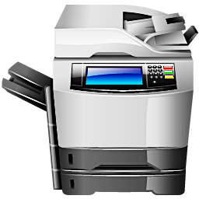
Example #2: Blind Access to Printer
Innovative Accessibility Design for Hardware with Closed Functionality
Workspace
Shared Printer in Common Area
Mobile Devices
Blind
Accessible Printer
Personal Computer
Printer – Braille, Audio Jack/Volume, Screen Reader, Keypad, Focus Indicator
Notes:
Blind User Scenario
Blind users will utilize printer related applications from their personal computer and mobile devices.
When they use a shared printer in a common area, then must be able to:
Locate Braille instructions for finding the headset jack and activating speech mode.
Inserting a personal headset, activating the built-in screen reader, and adjusting the volume of speech output.
Tactilely distinguish and identify hardware operable parts and controls.
Change the control panel screen to high contrast if available, if they have some vision.
Navigate all available control panel/display content using navigation keys or some other accessible method.
Having an on-screen focus indicator.
Optionally, some printer have an extended keyboard which can also be used to support navigation among control panel/display content etc.

Slide 18
Example #2: Low Vision Access to Printer
Innovative Accessibility Design for Hardware with Closed Functionality
Workspace
Shared Printer in Common Area
Low
Vision
Mobile Devices
Accessible Printer
Personal Computer
Printer – Display sans serif fonts with contrast, focus indicator, etc.
Notes:
Low Vision User Scenario
Users with low or limited vision may experience difficulties using printers. Vision impairments include:
Color blindness - Difficulty distinguishing between colors such as between red and green, or between yellow and blue, and sometimes inability to perceive any color
Low vision - Includes poor acuity (vision that is not sharp), tunnel vision (seeing only the middle of the visual field), central field loss (seeing only the edges of the visual field), and clouded vision.
To effectively use a printer, users with low or limited vision typically rely on the following types of features:
Operable Controls
Having sufficient color contrast for labels, icons and other identifiers;
Being able to tactilely distinguish and identify hardware controls;
Control Panel / Display Screen
Having sans serif and easy-to-read text on display screen content;
Changing the control panel screen to high contrast or inverted color;
Zooming the control panel screen;
Using a screen reader to access control panel screen content;
Having content that does not use color alone to convey meaning.
Having a visual focus indicator synchronized with the screen reader / text-to-speech output.

Slide 19
Example #2: Mobility/Dexterity Access to Printer
Innovative Accessibility Design for Hardware with Closed Functionality
Workspace
Shared Printer in Common Area
Low
Mobility/ Dexterity
Mobile Devices
Accessible Printer
Personal Computer
Printer – Keypad / Keyboard, Reach to Operable Parts, Display Screen Visibility, etc.
Notes:
Low Mobility / Low Dexterity User Scenario
Users who have limited reach, dexterity or strength (i.e. “motor impairments”) may experience difficulties using printers. Motor impairments include weakness and limitations of muscular control (such as involuntary movements including tremors, lack of coordination, or paralysis), limitations of sensation, joint disorders (such as arthritis), pain that impedes movement, and missing limbs. To effectively use a printer, users with motor impairments rely on the following types of features:
Being able to operate printer controls with one hand, with limited strength, and without tight grasping, pinching, or twisting of the wrist.
Being able to reach each operable control from a wheelchair.
Using a hardware back keyboard or keypad as an alternative to on-screen keyboards and keypads.
Having alternatives to biometric controls.
Ensuring that control panel screens are visible from a wheelchair.
Having an opportunity to indicate that more time is needed for timed responses.

Slide 20
Example #2: Example Stack Considerations
Innovative Accessibility Design for Hardware with Closed Functionality
Hardware / Installation
Display size/position/adjustment
EZ Access® keypad or other method to navigate / select (alternative to touch)
Operable parts access including force, tactile discernibility, forward/side reach
Audio connector with volume control
Optional QWERTY keyboard attachment
Braille instructions
Firmware / OS/ Assistive Features
Activation and reset of accessibility settings
Focus indicator
Sufficient color / contrast on display (optional high contrast)
Embedded screen reader
Application(s)
Kiosk, ancillary web /mobile apps meet WCAG Level A and Level AA success criteria
Tested for compatibility with built-in or third party assistive tech (e.g. screen reader)

Slide 21
Implications for Solution Providers

Slide 22
Implications: Hardware Solution Lifecycle
Innovative Accessibility Design for Hardware with Closed Functionality
Designing for accessible hardware with closed functionality requires attention throughout the development life cycle.
Requirements
Include Accessibility
Checklists
Design
Style Guide
Consult PWDs
Development
Follow Best Practices
QA/Testing
Release
Accessibility Tests by Need
Document Features
Accessible Support
VPATs
Design Alternatives
Test Prototypes and Access Features
Use Case Tests w/ PWDs
Image Credits (From Left): (1) Created by Freepik; (2) GA Institute of Technology; (3) Created by Freepik; (4) Created by Makyzz (Freepik.com); (5) Created by Photoroyalty (Freepik.com)
Notes:
LONG DESCRIPTION OF GRAPHIC – Shows implications for solution providers in these phases of the development life cycle:
Requirements
Map Applicable Requirements to Functionality/Use
Best Practices Checklists
Design
Style Guide
Accessible Design Alternatives
Consult with and test designs with PWDs
Development
Follow Best Practices
Test Prototypes
Unit Test for Accessibility where Possible
QA/Testing
Full Accessibility Testing by Functional Need
Use Case Testing with Assistive Features/Tech
Release
Document Access Features in Docs
Accessible Support
VPAT Conformance Statements

Slide 23
Q&A and Resources

Slide 24

Resources
Innovative Accessibility Design for Hardware with Closed Functionality
U.S. Access Board, Comparison of the Revised 508 Standards to the Original 508 Standards: Table A-3 Original Hardware Requirements to New Hardware Requirements
U.S. Access Board, Text of the [508 Refresh] Standards and Guidelines
KioWare, Assistive Technologies for Deploying Kiosks
Level Access, Accessibility 101 for the Hardware Industry

Slide 25





Thank You
Innovative Accessibility Design for Hardware with Closed Functionality
Contact
Follow Us
@LevelAccessA11y
Bill Curtis-Davidson
Sr. Director, Strategic Consulting Services
bill.curtis-davidson@levelaccess.com
Level Access
Level Access
Level Access Blog
Slide Deck Available for Download at: https://www.levelaccess.com/csun18/

